Slide 1
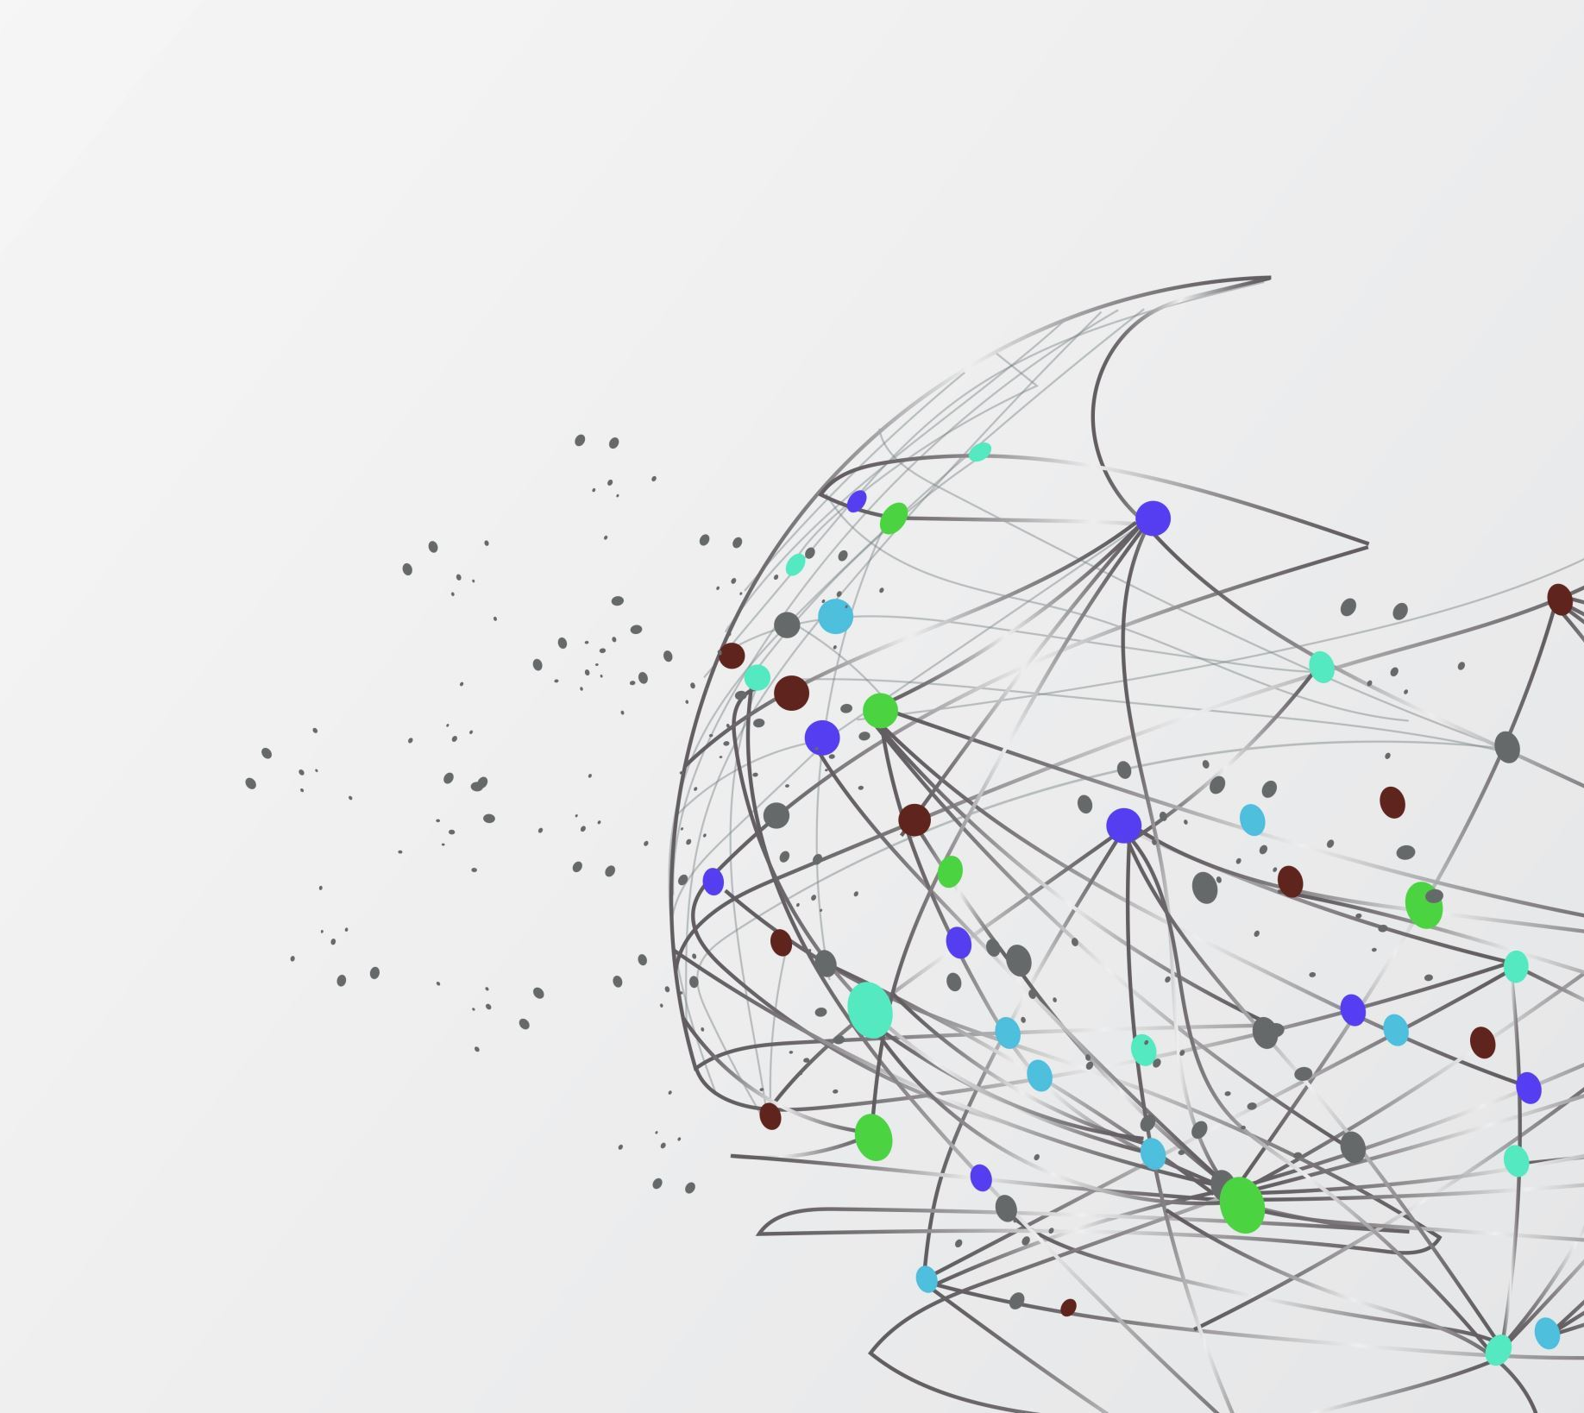
RV32I
Multi cycle implementation

Slide 2
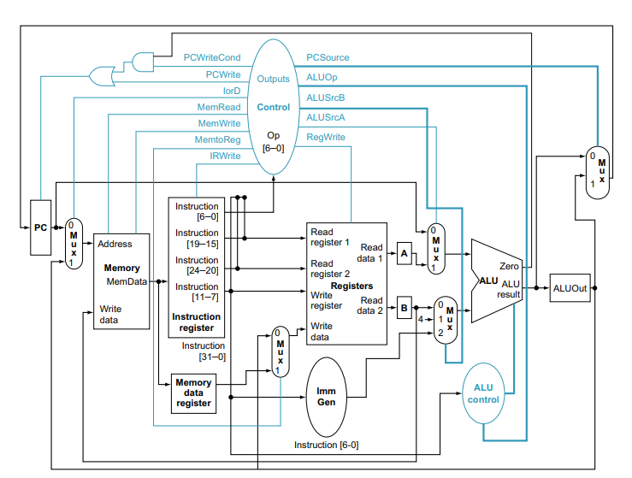
PATTERSON & HENESSY DESIGN
My design is the same as this, as I have made no changes in this design

Slide 3
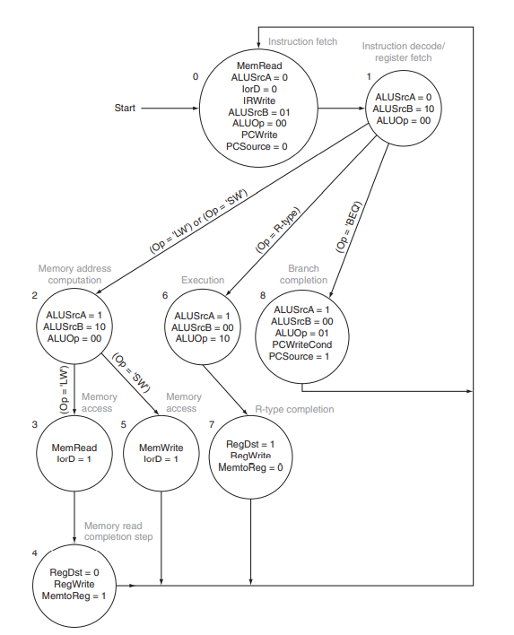
FSM for Control Unit
I have used one more state, state 9, for I load immediate. As Patterson Henessy design does not include this instruction type it does not have this state. The path that is followed is State 1 -> State 9 -> State 7
and so on.

Slide 4
Simulation Results
Tested the processor for different instruction types by loading these instruction in data memory and simulated the result.

Slide 5
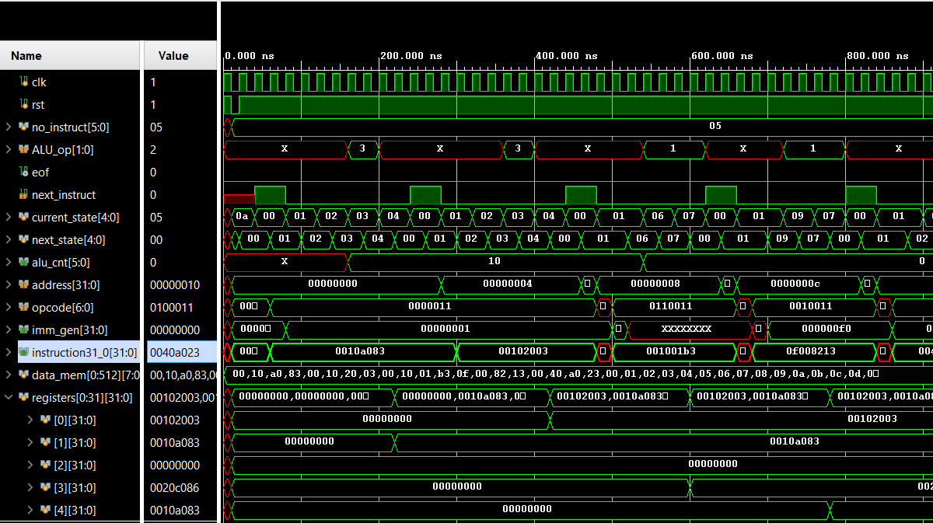

Slide 6
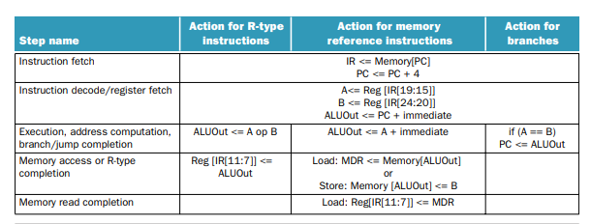
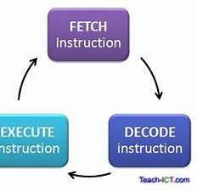
Fetch Decode Execute
My processor works in this form.
It is an unpipelined design therefore it does not fetch next instruction until first is executed.
This can be seen from my waveform

Slide 7
Presented By
Nofal Elahi

